Slide 1

Sentiment Analysis with N-Gram and SVM
Daniel Santoso / 2201756506
Boban Nathaniel Seputra / 2201762540
Luwis Lim / 2201761771
Steven Odolf Yuwono / 2201758045

Slide 2
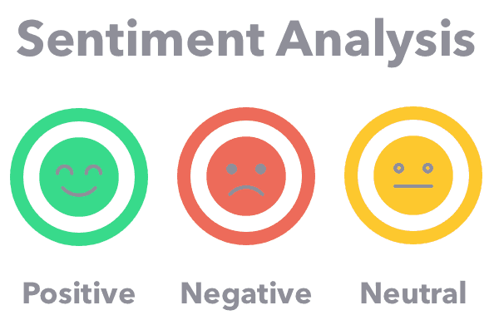
Introduction
Sentiment analysis refers to the use of NLP to systematically identify, extract, quantify, and study affective states and subjective information
https://mk0ecommercefas531pc.kinstacdn.com/wp-content/uploads/2019/12/sentiment-analysis.png

Slide 3
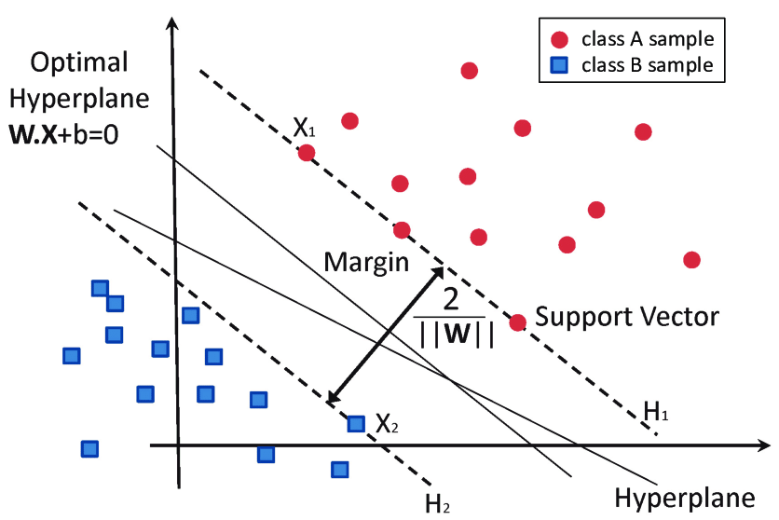
Method
N-Gram
Contiguous sequene of n-items from a given sample of text or speech
SVM (Support Vector Machine)
Objective: find a hyperplane in an N-dimensional space that distinctly classifies the data points
https://www.researchgate.net/publication/304611323/figure/fig8/AS:668377215406089@1536364954428/Classification-of-data-by-support-vector-machine-SVM.png

Slide 4
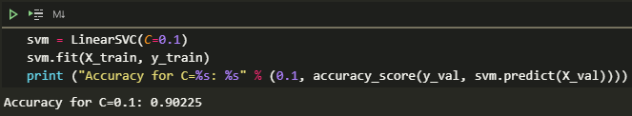
Results and Discussion
*Code attached

Slide 5
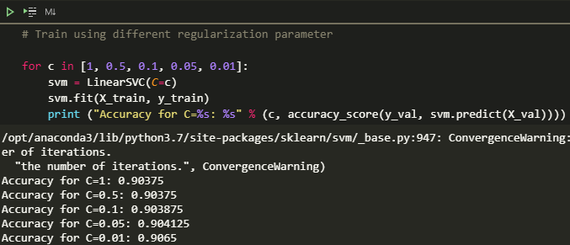
Results and Discussion
*Code attached

Slide 6
Conclusion
The conclusion of our test using sentiment analysis for movie reviews turns out to be good. Because the accuracy that we got is 0.9065 which means that the algorithm can predict 9/10 cases.
There are many methods to be used besides N-Gram and SVM, for example BERT is now giving better state-of-the-art results.

